Slide 1
Constructing and Modeling Text-Rich Information Networks Using Phrase Mining
Jialu Liu
Dec. 1st, 2015
Department of Computer Science
University of Illinois at Urbana-Champaign

Slide 2
Outline
Big Textual Data
Phrase Mining
Document Keyphrase Extraction
Text-Rich Information Network Embedding
Summary

Slide 3
A Deluge of Data

Slide 4
80% of business-relevant information originates in unstructured form, primarily text.

Slide 5

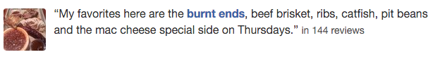


Working with Text is A Big Challenge: Short, Noisy

Slide 6
Working with Text is A Big Challenge: Structured Metadata
hashtag
business
venue
location
user
tweets
reviews
papers
user
author

Slide 7
Text-Rich Information Networks from Massive Text
Words:
dbscan, methods, clustering, process, …
Document
Representation
Topics:
[k-means, clustering, clusters, dbsca, …]
[clusters, density, dbscan, clustering, …]
[machine, learning, knowledge, mining, …]
documents
Knowledge base concepts:
data mining: /m/0blvg
clustering analysis: /m/031f5p
dbscan: /m/03cg_k1
Document Keyphrase:
dbscan: [dbscan, density, clustering, ...]
clustering: [clustering, clusters, partition, ...]
data mining: [data mining, knowledge, ...]
“DBSCAN is a method for clustering in process of knowledge discovery.”

Slide 8
Modeling Text-Rich Information Networks: Heterogeneity
Entities Associated with Documents
dbscan
database
documents
clustering
data mining
Knowledge are propagated between Entities and Quality Phrases

Slide 9
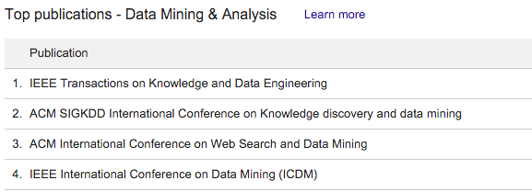
Useful Applications
Similarity Search:
- Database + Data Mining =
Multi-Aspect Mining
Information Networks
Data Cubes, OLAP
Frequent Pattern Mining
Categorization

Slide 10
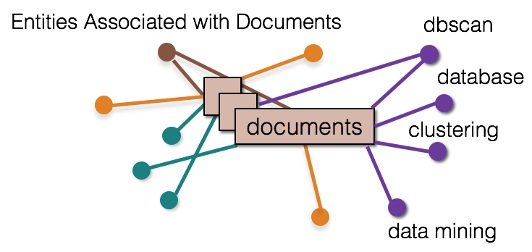
The Road Map
“DBSCAN is a method for clustering in process of knowledge discovery.”
Document Keyphrase:
dbscan: [dbscan, density, clustering, ...]
clustering: [clustering, clusters, partition, ...]
data mining: [data mining, knowledge, ...]
1. Phrase Mining (SIGMOD 2015)
2. Document Keyphrase Extraction (Submitted)
graphics
Edgar F. Codd
Knowledge discovery
SIGKDD
Data mining
3. Text-Rich Information Network Embedding (Target for KDD16)

Slide 11
Outline
Big Textual Data
Phrase Mining
Document Keyphrase Extraction
Text-Rich Information Network Embedding
Summary

Slide 12
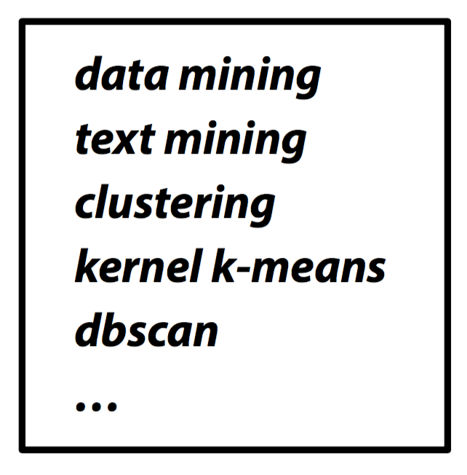
Phrase Mining
1. Quality Phrases
Input Raw Corpus
Document 1
Citation recommendation is an interesting but challenging research problem in data mining area.
Document 2
In this study, we investigate the problem in the context of heterogeneous information networks using data mining technique.
Quality Phrase Labels
Document 3
Principal Component Analysis is a linear dimensionality reduction technique commonly used in machine learning applications.
2. A segmenter to identify phrase mentions

Slide 13
Why Phrase Mining
Unigrams vs. Phrases
Unigrams (single words) are ambiguous
Example: “United”: United States? United Airline? United Parcel Service?
Phrase: A natural, meaningful, unambiguous semantic unit
Example: “United States” vs. “United Airline”

Slide 14
Traditional NLP-based Methods
Phrase mining was originated from the NLP community
Most NLP methods need heavy training and complex labeling
Costly and may not be transferable
May not fit domain-specific, dynamic, emerging applications
Scientific domains
Query logs
Social media, e.g., Yelp, Twitter

Slide 15
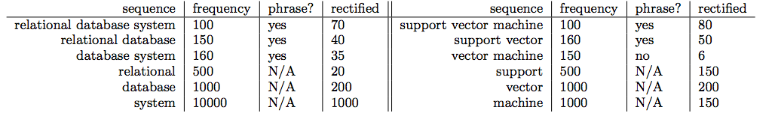
Traditional Data-Driven Methods
Raw frequency plays a big role
#(phrase) in corpus using string match
However, raw frequency could NOT reflect the quality of phrases
Need to rectify the frequency
Notes:
the goal of the rectification is to estimate how many times each word sequence should be interpreted in whole as a phrase in its occurrence context.

Slide 16
Rectification through Segmentation
Document 1
Citation recommendation is an interesting but challenging research problem in data mining area.
Document 2
In this study, we investigate the problem in the context of heterogeneous information networks using data mining technique.
Document 3
Principal Component Analysis is a linear dimensionality reduction technique commonly used in machine learning applications.
Quality Phrases
Segmented Corpus
The phrase quality guides the segmentation, and the segmentation rectifies the phrase quality estimation.

Slide 17
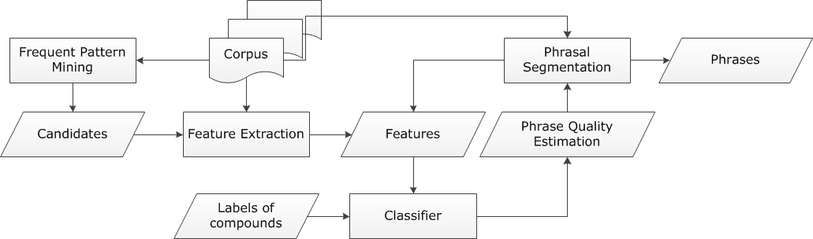
Framework
Feedback through Rectification
Generating Candidates
Quality Estimation through Classification

Slide 18
Candidate Generation
Build a candidate phrases set by frequent pattern mining
Mining frequent k-grams
k is typically small, e.g. 6 in our experiments

Slide 19
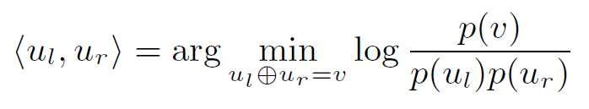
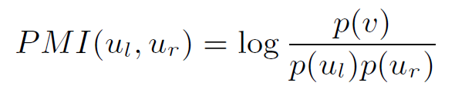
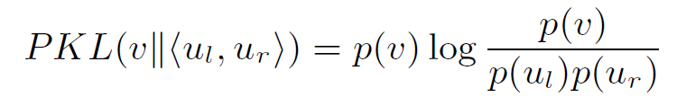
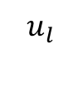
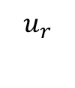
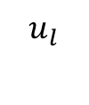
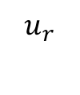
Feature Generation I
Deriving Concordance Features
Partition a phrase into two parts to check whether the co-occurrence is significantly higher than pure random
support vector machine this paper demonstrates
Pointwise mutual information:
Pointwise KL divergence:
]
$$u_{l}$$
$$u_{r}$$
$$u_{l}$$
$$u_{r}$$
Notes:
The additional p(v) is multiplied with pointwise mutual information, leading to less bias towards rare-occurred phrases

Slide 20
Features Generation II
Deriving Informativeness Features
Quality phrases typically start and end with a non-stopword
“machine learning is” v.s. “machine learning”
Use average IDF over words in the phrase to measure the semantics
Usually, the probabilities of a quality phrase in quotes, brackets, or connected by dash should be higher (punctuations information)
“state-of-the-art”, “(Latent Dirichlet Allocation)”

Slide 21
Classification
Limited Training
Labels: Whether a phrase is a quality one or not
“support vector machine”: 1
“the experiment shows”: 0
For ~1GB corpus, only 300 labels
Random Forest as our classifier
Predicted phrase quality scores lie in [0, 1]

Slide 22
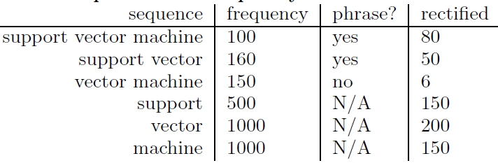
Segmentation
Segmentation can tell which phrase is more appropriate
A standard ⌈feature vector⌋ ⌈machine learning⌋ setup is used to describe...
“vector machine” is not counted towards the rectified frequency

Slide 23
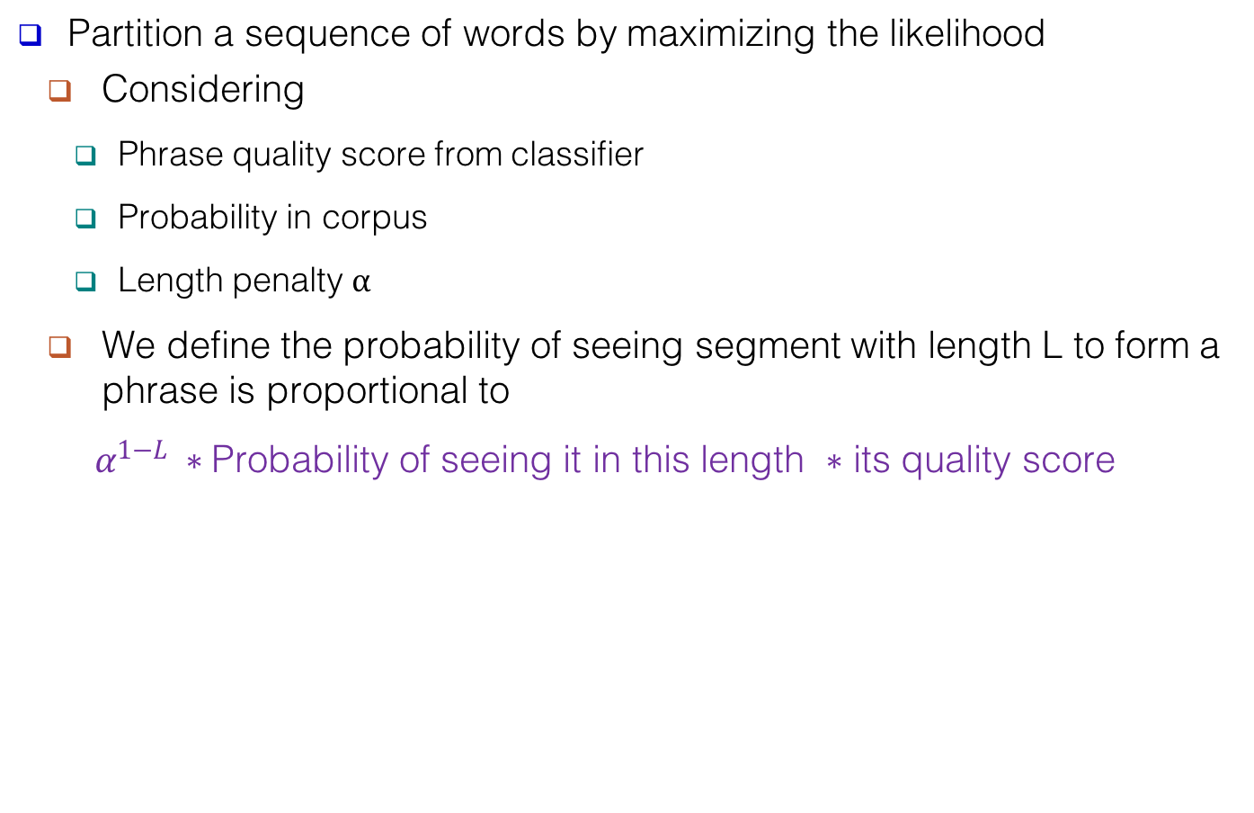
Objective Function for Segmentation
Partition a sequence of words by maximizing the likelihood
Considering
Phrase quality score from classifier
Probability in corpus
Length penalty $α$
We define the probability of seeing segment with length L to form a phrase is proportional to
$α^{1−L} ∗$Probability of seeing it in this length $∗$ its quality score

Slide 24
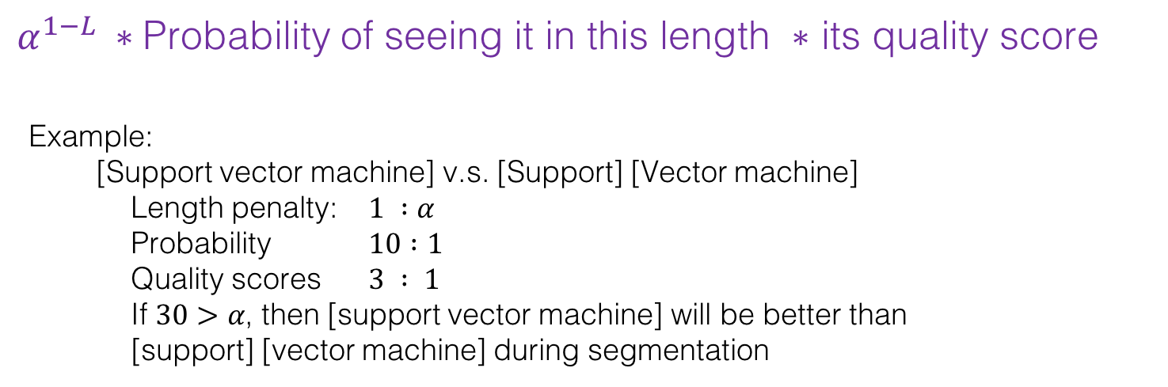
$α^{1−L} ∗$Probability of seeing it in this length $∗$ its quality score
Example:
[Support vector machine] v.s. [Support] [Vector machine]
Length penalty: $1 :α$
Probability $10 :1$
Quality scores $3 : 1$
If $30>α$, then [support vector machine] will be better than
[support] [vector machine] during segmentation

Slide 25
Feedback Loop
Feedback
Filter out phrases with low rectified frequency
Using rectified frequency, re-compute features previously with raw frequency
Effects on computing quality scores
np hard in the strong sense
np hard in the strong
data base management system

Slide 26
Performance Study
Other phase mining methods to be compared with
NLP chunking based methods
Chunks as candidates
Sorted by TF-IDF and C-value (K. Frantzi et al., 2000)
Unsupervised raw frequency based methods
ConExtr (A. Parameswaran et al., VLDB 2010)
ToPMine (A. El-Kishky et al., VLDB 2015)
Supervised method
KEA, designed for single document keyphrases (O. Medelyan & I. H. Witten, 2006)

Slide 27
Variations of the proposed method
ClassPhrase has the classification module
SegPhrase additionally has segmentation module (Blue)
SegPhrase+ additionally has feedback module (Red)

Slide 28
Datasets
Popular Wiki Phrases
Based on Wiki anchor texts
~7K high quality phrases
Pooling
Sampled 500 * 7 Wiki-uncovered phrases
Evaluated by 3 reviewers independently
Dataset | #docs | #words | #labels
DBLP | 2.77M | 91.6M | 300
Yelp | 4.75M | 145.1M | 300

Slide 29
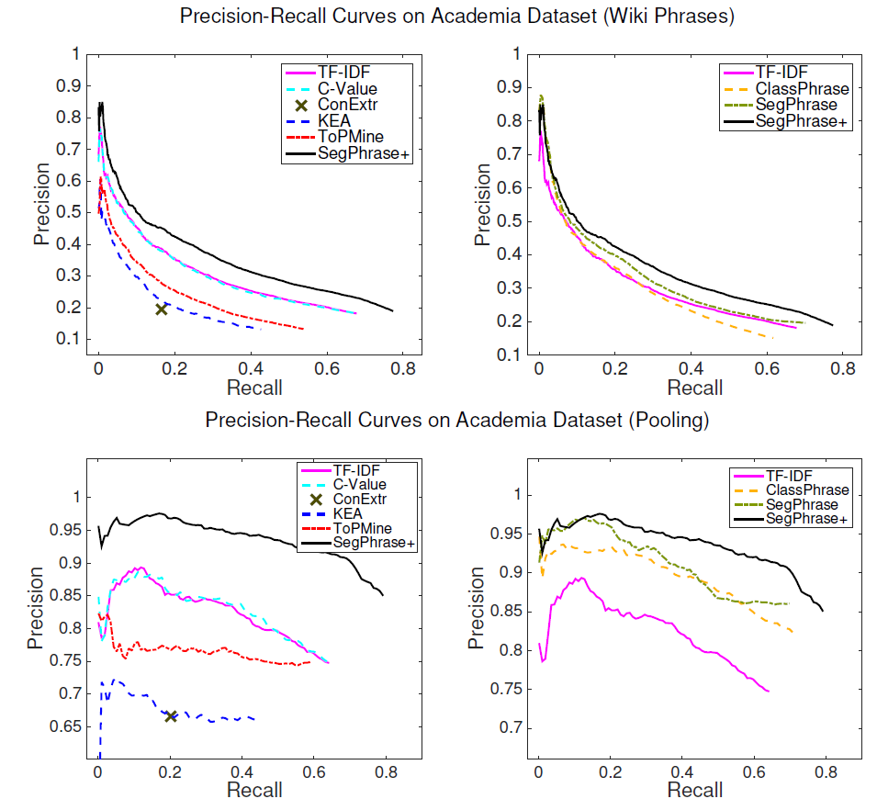
Compare with other baselines
TF-IDF
C-Value
ConExtr
KEA
ToPMine
SegPhrase+
Compare with our 3 variations
TF-IDF
ClassPhrase
SegPhrase
SegPhrase+
29

Slide 30
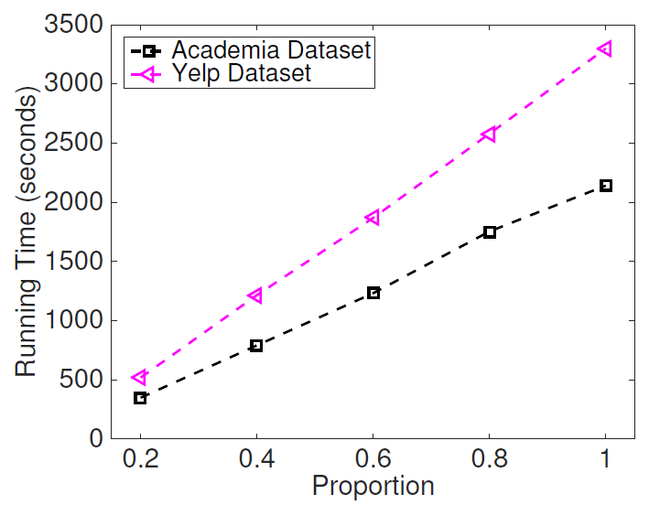
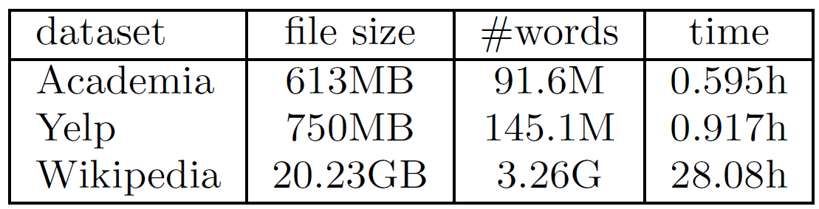
SegPhrase+ is linear to the size of corpus!

Slide 31
Interesting Phrases Generated from Titles and Abstracts of SIGMOD
Query | SIGMOD
Method | SegPhrase+ | Chunking (TF-IDF & C-Value)
1 | data base | data base
2 | database system | database system
3 | relational database | query processing
4 | query optimization | query optimization
5 | query processing | relational database
… | … | …
51 | sql server | database technology
52 | relational data | database server
53 | data structure | large volume
54 | join query | performance study
… | … | …
201 | high dimensional data | efficient implementation
202 | location based service | sensor network
203 | xml schema | large collection
204 | two phase locking | important issue
205 | deep web | frequent itemset
… | … | …
Only in SegPhrase+
Only in Chunking

Slide 32
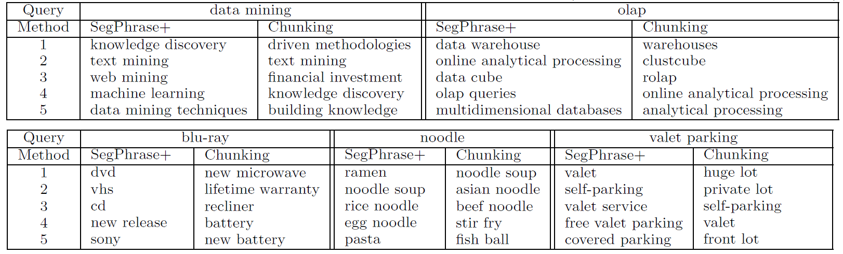
Similarity Search on Word2vec Results from Segmented Corpus
In response to a user’s phrase query, SegPhrase+ generates high quality, semantically similar phrases
In DBLP, query on “data mining” and “OLAP”
In Yelp, query on “blu-ray”, “noodle”, and “valet parking”

Slide 33
Recent Progress
Distant Training: No need of human labeling
Training using general knowledge bases
E.g., Freebase, Wikipedia
Multi-languages: Beyond English corpus
Extensible to mining quality phrases in multiple languages
SegPhrase+ works on Chinese and Arabic
Integrating NLP POS tagging within segmentation module
Notes:
Automatic generation of labels for SegPhrase+
Based on label propagation
The principles of SegPhrase+ are not dependent on a particular natural language

Slide 34
Chinese SegPhrase+ from Wiki training data
Rank | Phrase | In English
… | … | …
62 | 首席_执行官 | CEO
63 | 中间_偏右 | Middle-right
… | … | …
84 | 百度_百科 | Baidu Pedia
85 | 热带_气旋 | Tropical cyclone
86 | 中国科学院_院士 | Fellow of Chinese Academy of Sciences
… | … | …
1001 | 十大_中文_金曲 | Top-10 Chinese Songs
1002 | 全球_资讯网 | Global News Website
1003 | 天一阁_藏_明代_科举_录_选刊 | A Chinese book name
… | … | …
9934 | 国家_戏剧_院 | National Theater
9935 | 谢谢_你 | Thank you
… | … | …

Slide 35
Outline
Big Textual Data
Phrase Mining
Document Keyphrase Extraction
Text-Rich Information Network Embedding
Summary

Slide 36
Document Representation
Words:
dbscan, methods, clustering, process, …
Document
Representation
Topics:
[k-means, clustering, clusters, dbsca, …]
[clusters, density, dbscan, clustering, …]
[machine, learning, knowledge, mining, …]
documents
Knowledge base concepts:
data mining: /m/0blvg
clustering analysis: /m/031f5p
dbscan: /m/03cg_k1
Document Keyphrase:
dbscan: [dbscan, density, clustering, ...]
clustering: [clustering, clusters, partition, ...]
data mining: [data mining, knowledge, ...]

Slide 37
Traditional Methods
Bag-of-Words (Phrases)
Cons: sparse on short texts

Slide 38
Topic models
Cons: Difficulty in inferring topic semantics

Slide 39
Concept-based models
Cons: rely on human-curated knowledge base

Slide 40
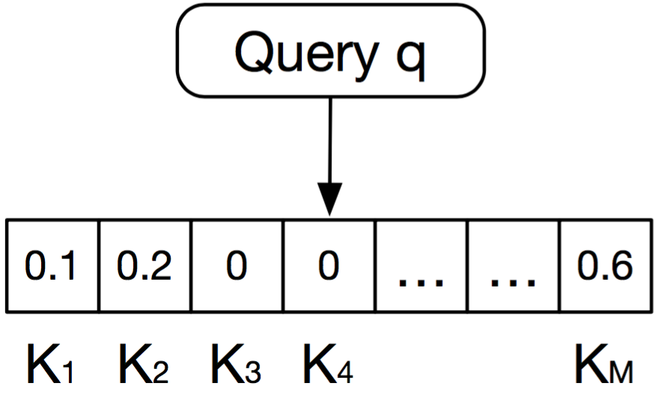
Document Representation Using Keyphrases
Use quality phrases as the entries in the vector and
Identify document keyphrases (subset of quality phrases) by evaluating relatedness between (doc, quality phrase)
Unsupervised model

Slide 41
Challenges
How to identify document keyphrases?
Can be latent mentions
Relatedness scores
How to deal with relationship between quality phrases?

Slide 42
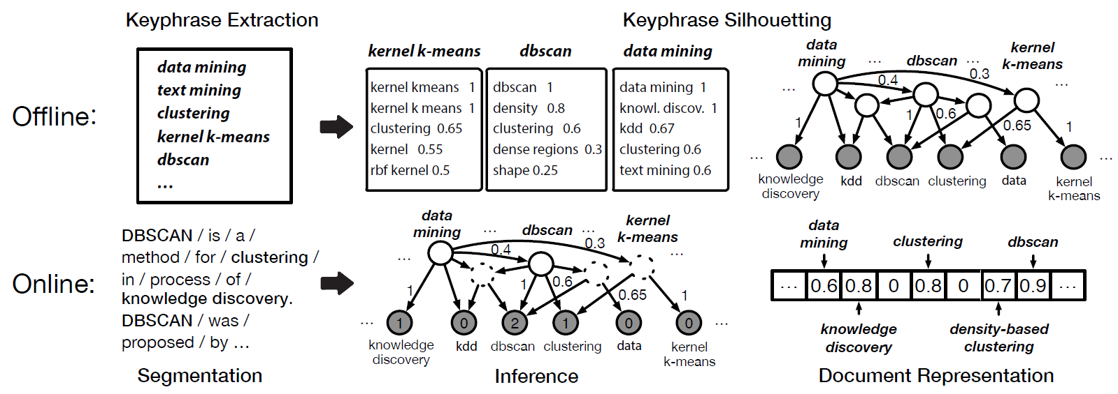
General Ideas
How to identify document keyphrases?
Powered by Bayesian Inference on “Quality Phrase Silhouette”
Quality Phrase Silhouette: Topic centered on quality phrase
“Reverse” topic models
“Pseudo content” for quality phrase

Slide 43
How to deal with relationship between quality phrases?
Phrases are interconnected as a Directed Acyclic Graph
Networking
Text Mining
Data Mining

Slide 44
Framework for Latent Keyphrase Inference (LAKI)

Slide 46
Quality Phrase Silhouette
Learning Hierarchical Bayesian Network (DAG)
Binary Variables

Slide 47
Model Learning
Model Learning: learning link weights
Structure Learning: learning network structure
Weight?

Slide 48
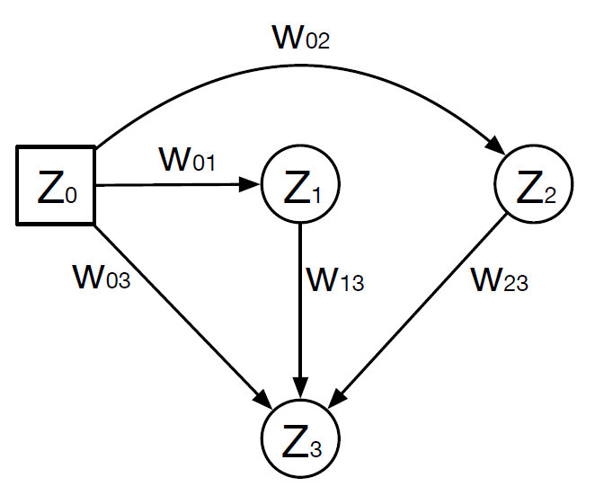
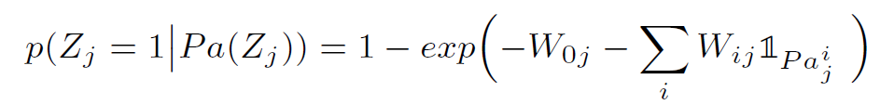
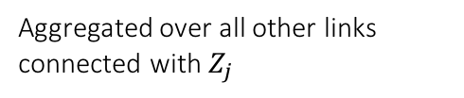
Use Z to represent K (quality phrases) and T (content units)
Noisy-OR
A parent node is easier to activate its children when the link weight is larger
A child node is influenced by all its parents
Noise / Prior
Aggregated over all other links connected with $Z_{j}$

Slide 50
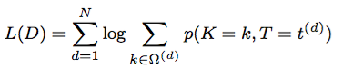
Maximum Likelihood Estimation
Training data: Documents
Expectation-step:
For each document, collect sufficient statistics
Link firing probability
Node activation probability
Maximization-step:
Update link weight
Partially observed document keyphrases
Fully observed content units

Slide 51
Structure Learning
Model Learning: learning link weights
Structure Learning: learning network structure
Which node pair to connect?

Slide 52
Quality phrases are connected to content units
Help infer document keyphrases from content units
Quality phrases are interconnected
Help infer document keyphrases from other keyphrases

Slide 53
A Heuristic Approach
Data-Driven, DAG, similar to ontology
Heuristic:
Two nodes are connected only
Closely Related: word2vec
Co-occur frequently
Links are always point to less frequent nodes
Work well in practice

Slide 55
Inference
When do we need inference？
Expectation step in model learning
New documents
Why is it slow?
NP hard to compute posterior probability for Noisy-Or networks
Approximate inference instead

Slide 56
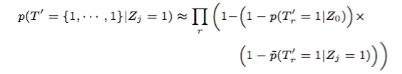
Pruning
Intuition:
Given a document, only a few quality phrases can be relevant
Propose a measure to rank quality phrases
Noise/Prior
From Zj

Slide 57
A
A
0.4
0.7
0.7
0.21
B
C
B
C
0.5
0.3
0.5
0.3
D
D

Slide 58
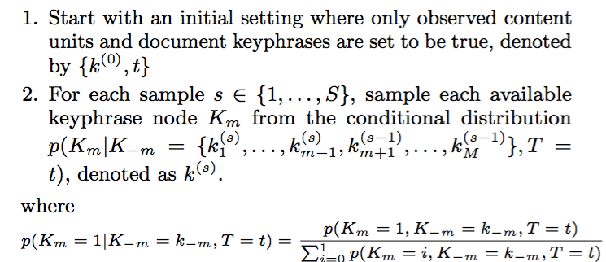
Sampling
Intuition:
Approximate M and P by iteratively sampling node states
Gibbs sampling

Slide 59
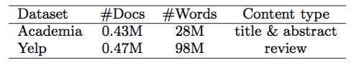
Experiments
Two text-related tasks to evaluate document representation quality
Phrase relatedness
Document classification
Two datasets

Slide 60
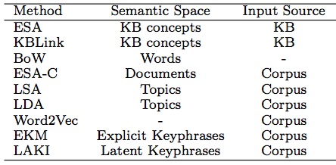
Methods
ESA (Explicit Semantic Analysis)
KBLink uses link structure in Wikipedia
BoW (bag-of-words)
ESA-C extends ESA by replacing Wiki with domain corpus
LSA (Latent Semantic Analysis)
LDA (Latent Dirichlet Allocation)
Word2Vec is a neural network computing word embeddings
EKM uses explicit keyphrase detection

Slide 61
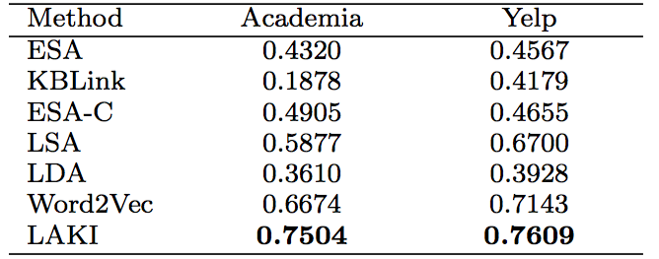
Phrase Relatedness Correlation

Slide 62
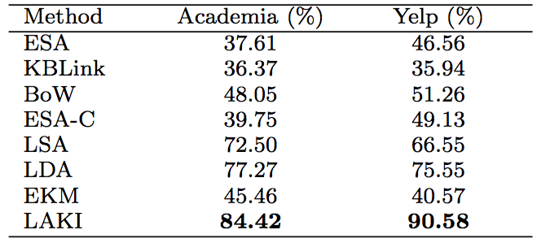
Document Classification

Slide 63
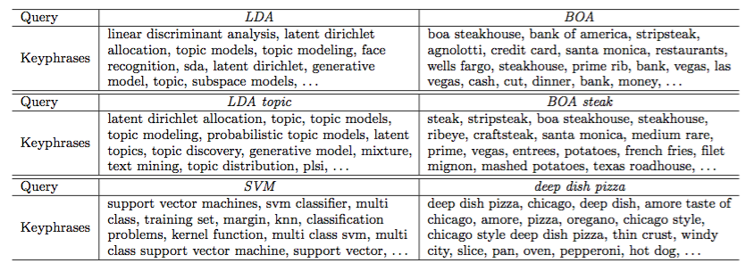
Case Study

Slide 64
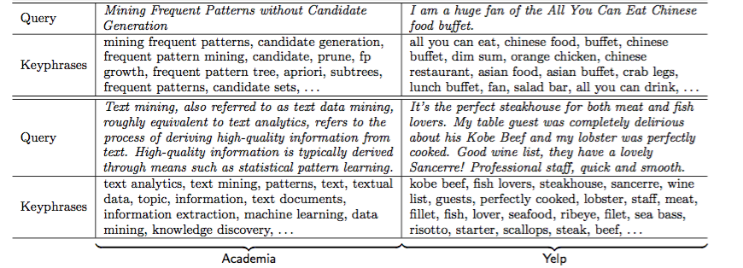

Slide 65
Time Complexity

Slide 66
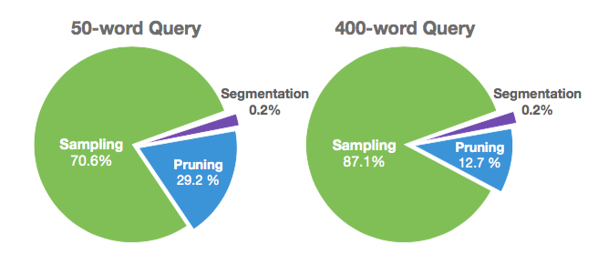
Breakdown of Processing Time

Slide 67
Outline
Big Textual Data
Phrase Mining
Document Keyphrase Extraction
Text-Rich Information Network Embedding
Summary

Slide 68
Modeling Text-Rich Information Networks: Heterogeneity
Entities Associated with Documents
dbscan
database
documents
clustering
data mining
Knowledge are propagated between Entities and Quality Phrases

Slide 69
Embedding In the Shared Space
Graphics
Edgar F. Codd
Knowledge discovery
Data mining
SIGKDD

Slide 70
Possible Approach – Multi-Aspect Mining
Information Networks
Data Cubes, OLAP
Frequent Pattern Mining
Intuition:
Context of nodes in text-rich information network can be clustered
An author work in different subareas
A restaurant serve different types of food
Better to use multiple embeddings

Slide 71
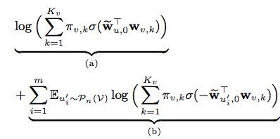
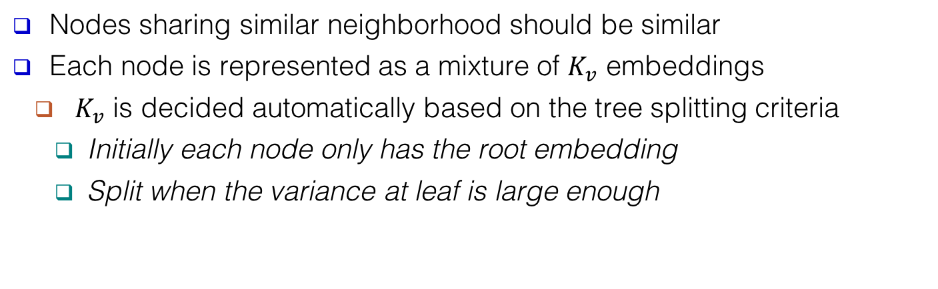
Modeling observed links
Negative Sampling
Nodes sharing similar neighborhood should be similar
Each node is represented as a mixture of $K_{v}$ embeddings
$K_{v}$ is decided automatically based on the tree splitting criteria
Initially each node only has the root embedding
Split when the variance at leaf is large enough

Slide 72
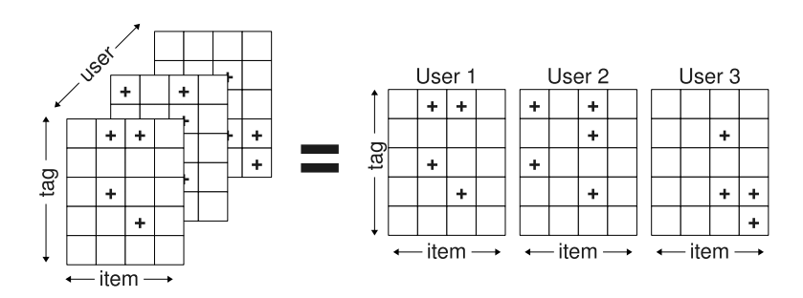
Possible Approach – Tensor-based Embedding
Intuition:
Considering text-rich information network as a tensor
Model a document with associated entities at a time
Can be applied to
networks with star-schema or reduced by meta-path
Unified mathematical formulation

Slide 73
Outline
Big Textual Data
Phrase Mining
Document Keyphrase Extraction
Text-Rich Information Network Embedding
Summary

Slide 74
Phrase Mining [SIGMOD15]
Quality Phrase Extraction
Segmentation
Document Keyphrase Extraction [Submitted to WWW16]
Latent keyphrase with relatedness score
Text-Rich Information Network Embedding [Ongoing, target for KDD16]
Multi-Sense Approach
Tensor-based Approach
Other related work
Clustering in Information Network
Matrix factorization approach [SDM13]
Generative Model [SDM15]
Efficient spectral clustering [IJCAI13]
w/ Network exploration [WSDM15]
Community detectability [SDM13]
Applications using Information Network
Author disambiguation [KDDCup13]
Constructing topic hierarchy [ICDM13]
Citation recommendation [KDD14]
Classification in Information Network
Sampling approach [KDD 13]

Slide 76
Appendix

Slide 77
How to Measure Phrase Quality?
Popularity
“information retrieval” vs. “cross-language information retrieval”
Concordance
“powerful tea” vs. “strong tea”
“active learning” vs. “learning classification”
Informativeness
“this paper” (frequent but not discriminative, not informative)
Completeness
“vector machine” vs. “support vector machine”

Slide 78
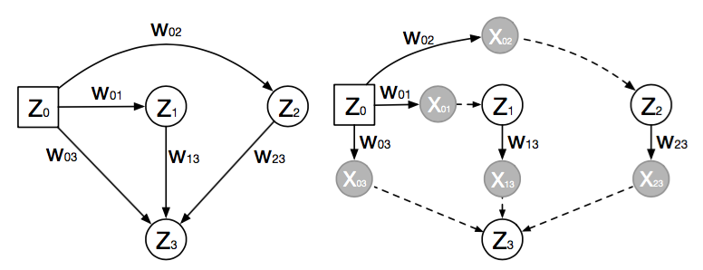
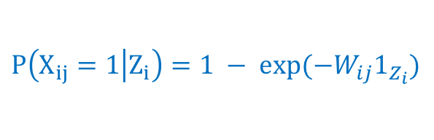
Go deeper into Noisy-Or networks?
$$P\left(X_{ij}=1 | Z_{i}\right)=1 − exp(−W_{ij}1_{Z_{i}})$$
OR

Slide 79
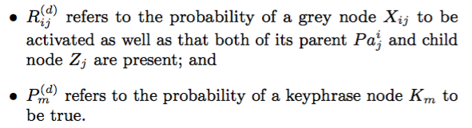
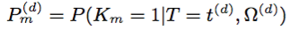
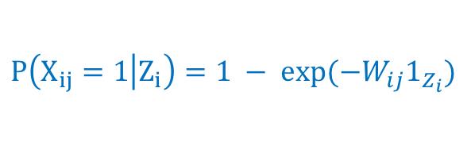
What to Compute in Model Training?
$$P\left(X_{ij}=1 | Z_{i}\right)=1 − exp(−W_{ij}1_{Z_{i}})$$
OR

Slide 80
Size of Quality Phrases after Pruning

Slide 81
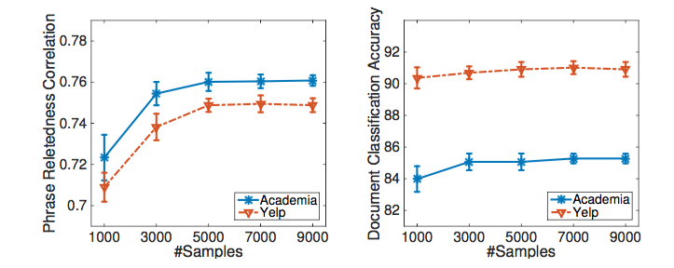
Iterations of Gibbs Sampling

Slide 82
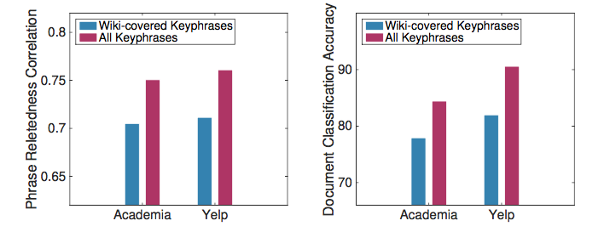
Different Size of Quality Phrases

Slide 83
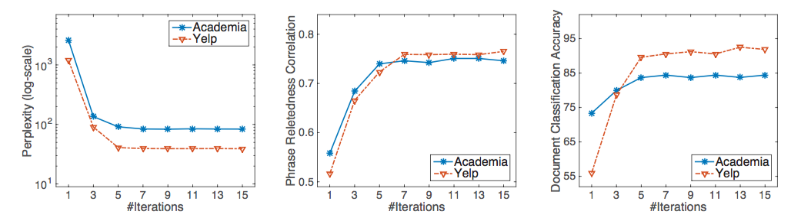
Convergence

